Slide 1


Slide 2
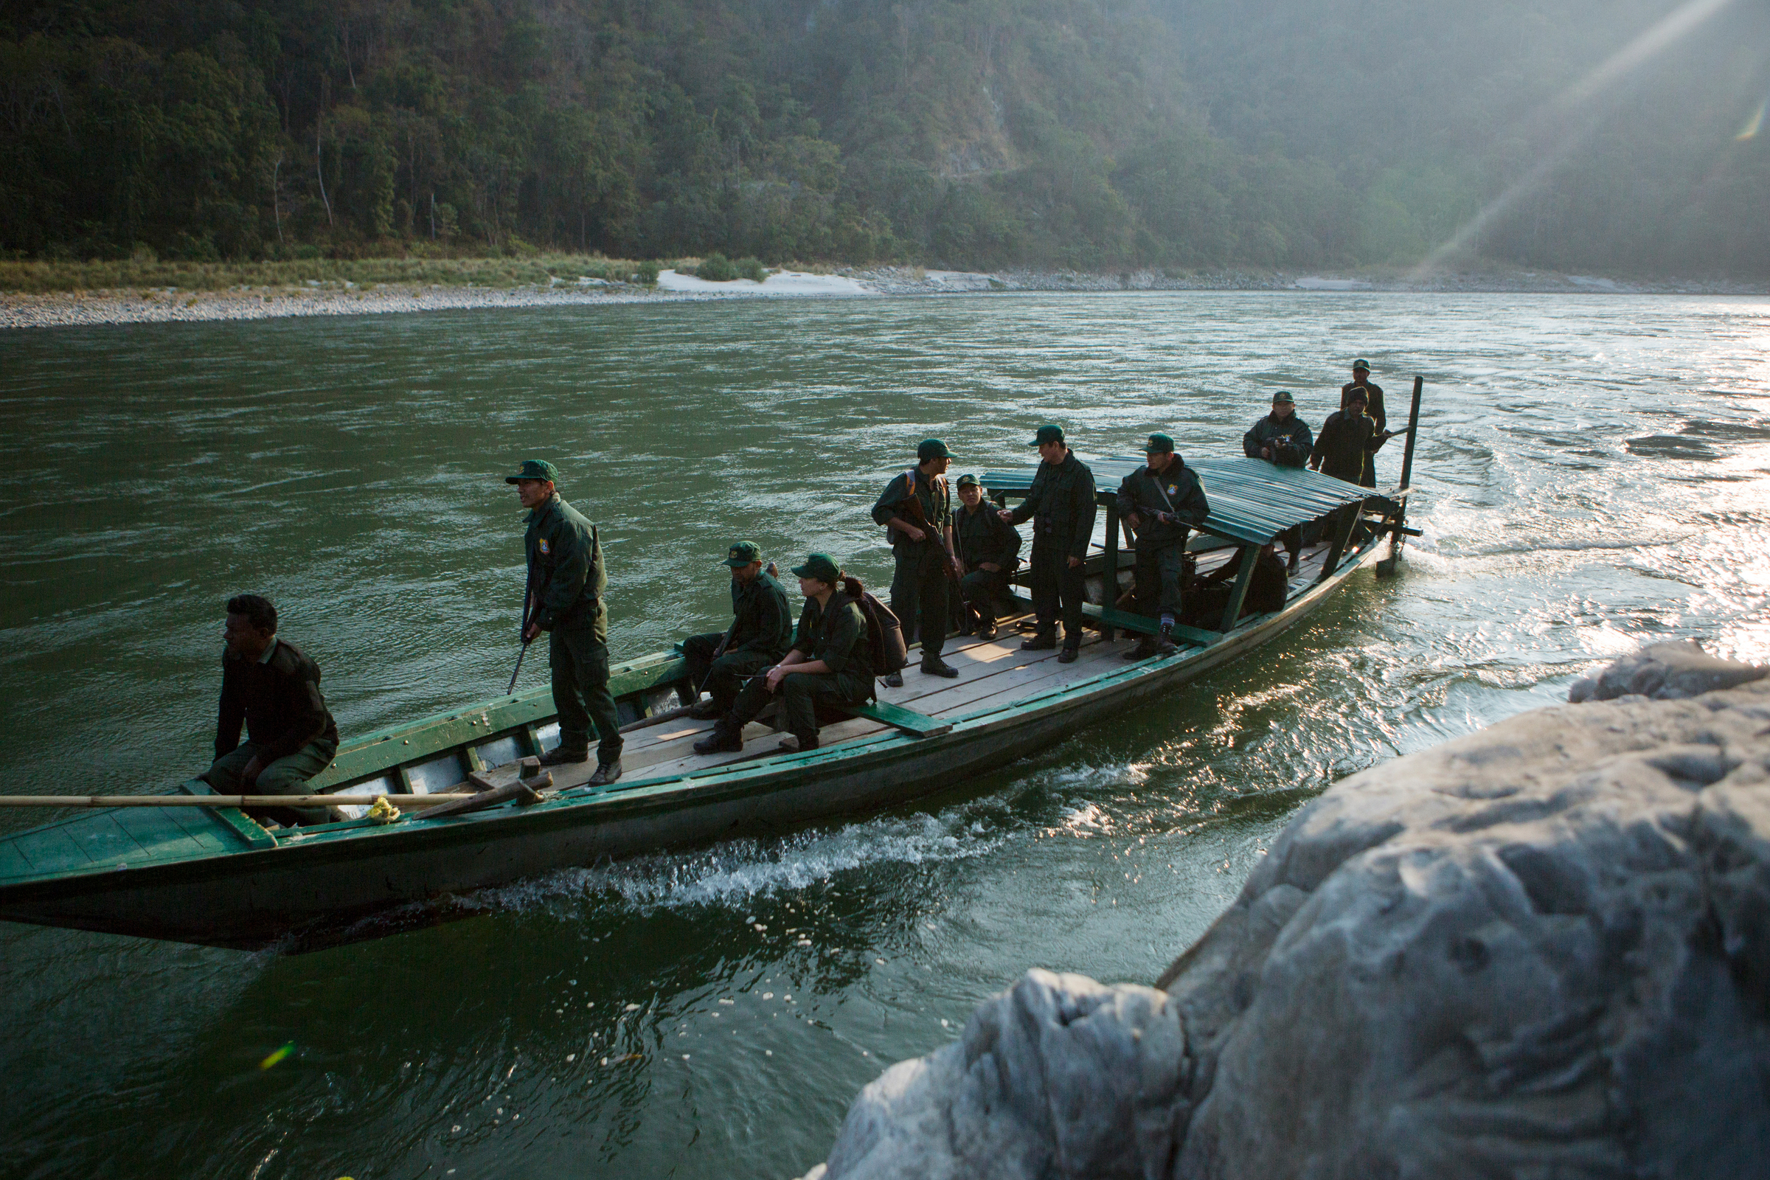
Project Development Kickoff and Training
WWF GEF Agency, 2020

Slide 3
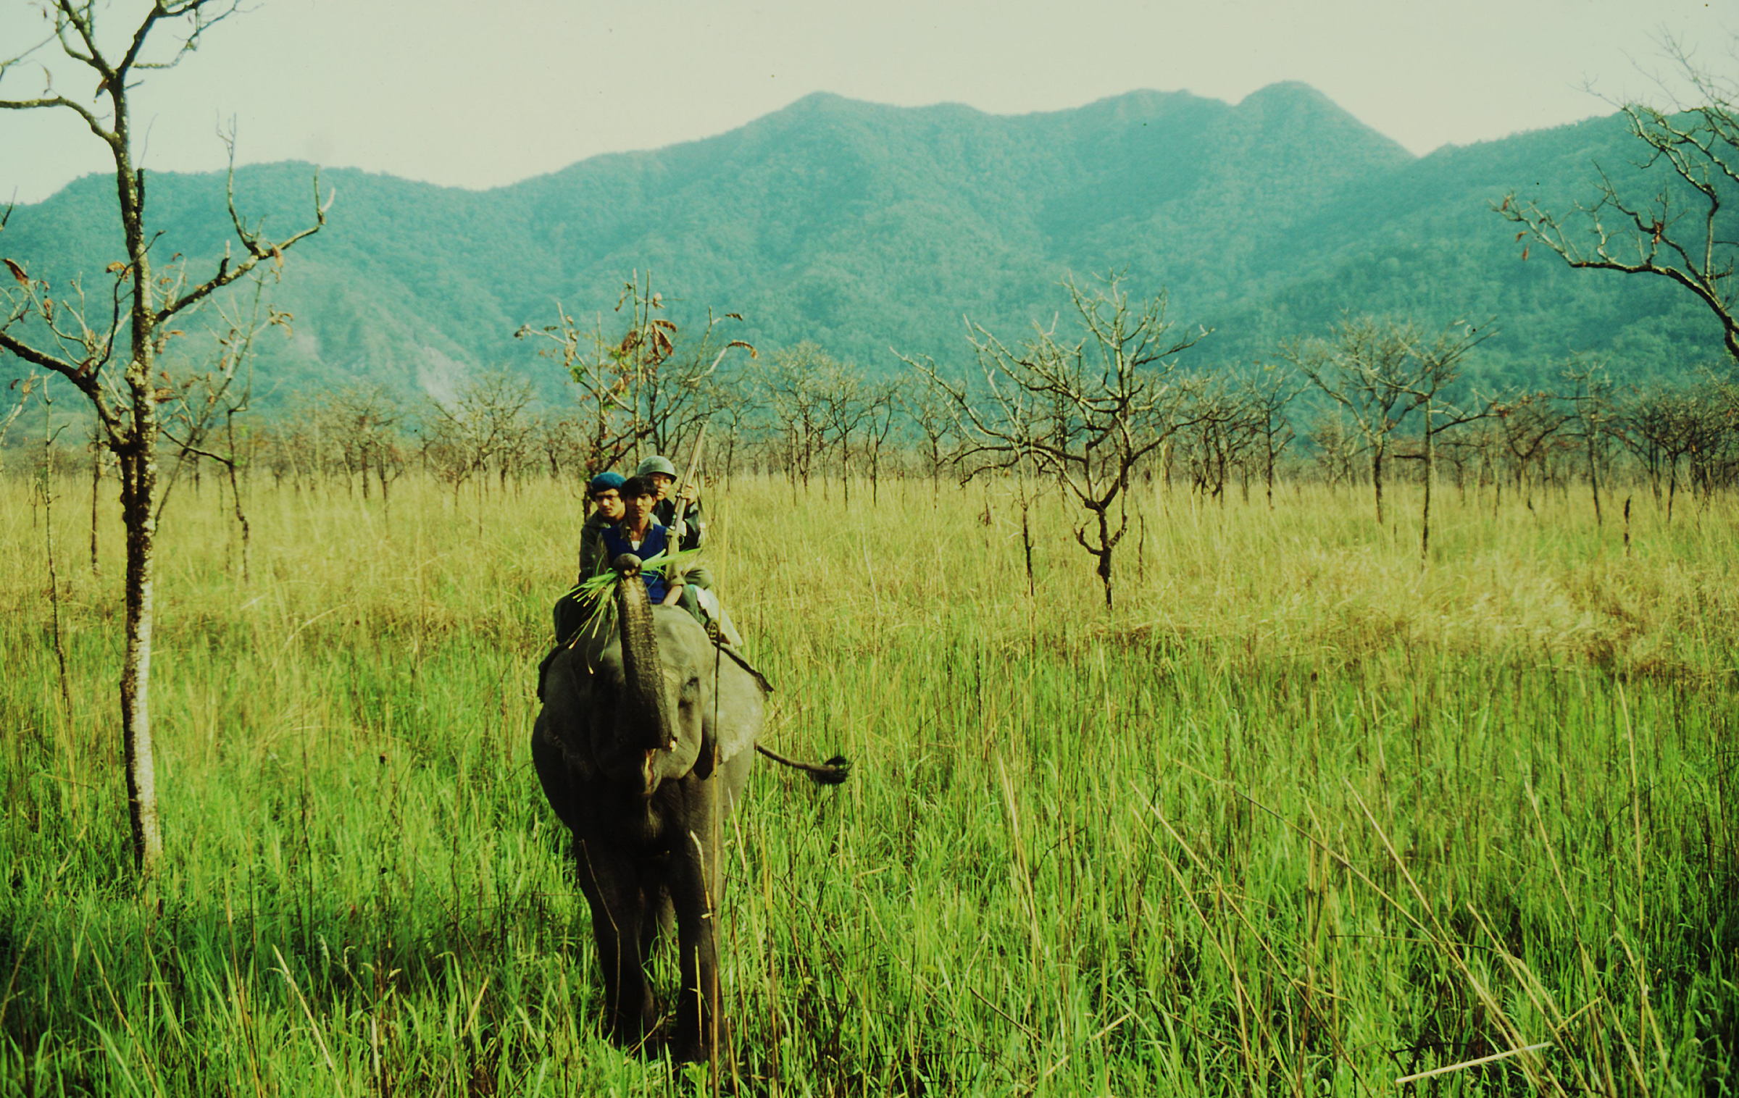

Designing a GEF Project:
Review Approved PIF
Environmental problem
Barriers
Baseline
Project objective
Project strategy
Global environmental benefits

Slide 4

Problems and Barriers Identified at PIF Stage
Environmental Problem
Fill this in based on PIF
Environmental Barriers
Fill this in based on PIF

Slide 5
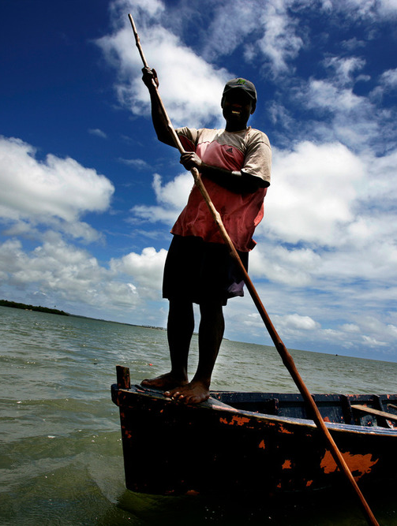
What is the Baseline?
Ongoing and planned activities underway without GEF financing
Fill this in based on PIF
Notes:
Explain that baseline is made up of activities carried out by main project partners, so not only WWF, but also government and other relevant implementing partners.
(a) Government-endorsed strategies and policies;
(b) Government announced investments in programs and infrastructure;
(c) Legislative frameworks;
(d) Energy development projects, agricultural/area development projects, etc;
(e) Transboundary accords, treaties and agreements; and
(f) International funding lines from bilateral and multilateral agencies.
Use highlighting to explain that activities that make up the baseline have to be current during (at least part of) the project’s lifetime. Projects and activities that exist during preparation, but that will be completed before project implementation, should be excluded.
Continuation of the baseline over time, constitutes the “Business-as-usual” scenario, also known as the “What-would-happen-without-the-GEF?” scenario.

Slide 6
Project Strategy
The project objective: Fill this in based on PIF
SCREEN SHOT OF TABLE B COMPONENT 1

Slide 7
Project Strategy
SCREEN SHOT OF TABLE B COMPONENTS 2&3

Slide 8
Global Environmental Benefits
Environmental problems solved or mitigated;
Threats/barriers removed;
Avoided loss of global environmental benefits, etc.
GEF Council approved targets/indicators
The identification of the Global Environmental Benefit(s) (GEBs) should be closely aligned with the GEF focal area strategies
Global Environmental Benefits
INCREMENTAL COST
GEF GRANT
BASELINE ACTIVITIES
Government Funds and other Existing Funds
Notes:
Explain that baseline is made up of activities carried out by main project partners, so not only WWF, but also government and other relevant implementing partners.
(a) Government-endorsed strategies and policies;
(b) Government announced investments in programs and infrastructure;
(c) Legislative frameworks;
(d) Energy development projects, agricultural/area development projects, etc;
(e) Transboundary accords, treaties and agreements; and
(f) International funding lines from bilateral and multilateral agencies.
Use highlighting to explain that activities that make up the baseline have to be current during (at least part of) the project’s lifetime. Projects and activities that exist during preparation, but that will be completed before project implementation, should be excluded.
Continuation of the baseline over time, constitutes the “Business-as-usual” scenario, also known as the “What-would-happen-without-the-GEF?” scenario.

Slide 9

Project and Project Document Development Process

Slide 10
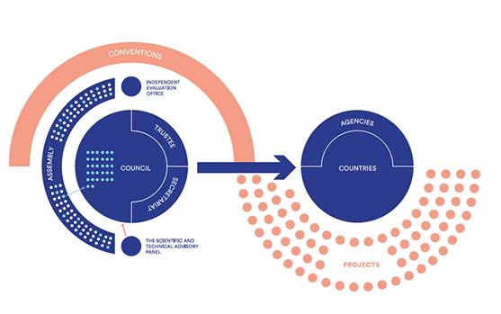
How does the GEF work?
WWF GEF Agency
FAO, IDB,CI, UNDP, CAF, etc.
Notes:
What is the GEF
Largest source of environmental public funding
Partnership of 183 countries working together with international institutions, civil society organizations and the private sector to address global environmental issues
Financial mechanism for 5 environmental conventions – CBD, UNCCD, UNFCC, Minamata and Stockholm Convention on POPs
Donor countries are usually developed and MICs, and recipient countries are developing and MICs
Each recipient country gets a national allocation (STAR), but cannot access directly, have to work through GEF Agency eg WWF GEF
Assembly - The GEF Assembly is composed of all 183 member countries, or Participants. It meets every three to four years at the ministerial level to review general policies; review and evaluate the GEF’s operation based on reports submitted to Council; review the membership of the Facility; and consider, for approval by consensus, amendments to the Instrument for the Establishment of the Restructured Global Environment Facility on the basis of recommendations by the Council.
From guidance from the conventions, to action on the ground
Council main governing body – 32 members appointed by constituencies of GEF countries
14 developed, 16 developing, 2 economies in transition
Approve work plan and operational policies and programs
Secretariat – coordinate overall implementation of GEF activities, led by the CEO appointed for 4 year terms by Council

Slide 11
Project/Program Cycle
Concept
PIF/PFD
ProDoc
Execution
Objective: Execute project according to ProDoc and in adherence to WWF GEF Policies and procedures
Objective: Design the project with partners in detail and define operational, institutional arrangements
Objective: Elaborate the concept to identify the GEBs, environmental problem, new solutions, and partnerships
Objective: Develop a GEFable project concept that integrates current GEF strategies, WWF and national priorities
PIF/PFD approval from GEF
ProDoc
Approval from GEF
3-6 months
Up to 12 months
12-18 months
3-6 years

Slide 12
Phase 1:
Plan
Consultant hired, work plan and budget, kick off workshop
Timeline and responsibilities
Phase 3: Consult & Refine
Stakeholder engagement on strategy, refine activities
Phase 4: finalize project design
Results framework
Phase 2: Detailed Design
Phase 5: Submit
Determine sites, stakeholder engagement plan
Technical Design
Validation workshop, Revise ProDoc, disclose Safeguards documents, Government and partners sign off, submit
Finalize implementation arrangement > Org chart
Detailed budget
Safeguards
Stakeholder engagement on baseline
Gender Analysis
ProDoc Process

Slide 13
Sections of the Prodoc
2.5 Gender
2.6 Safeguards
2.7 Monitoring and Evaluation
2.8 Budget
SECTION 3: GEF ALIGNMENT AND JUSTIFICATION
3.1 Additional Cost Reasoning and Benefits
3.2 Alignment with GEF Focal Area and/or Impact Program Strategies
3.3 Socioeconomic Benefits
3.4 Risks and proposed Mitigation Measures
3.5 Consistency with National Priorities or Plans
3.6 Innovativeness, Sustainability & Potential for Scaling up
3.7 Lessons learned during project preparation and from other relevant projects
EXECUTIVE SUMMARY SECTION 1: PROJECT BACKGROUND AND SITUATION ANALYSIS
1.1 Project Scope and Environmental Significance
1.2 Environmental Problem(s), Threats and Root Causes
1.3 Barriers addressed by the project
1.4 National and Sectoral Context
1.5 Baseline Scenario
1.6 Coordination with other relevant GEF & non-GEF Initiatives
SECTION 2: PROJECT EXECUTION STRATEGY
2.1 Project Objective and ToC
2.2 Project Components and Expected Outcomes
2.3 Institutional Arrangement
2.4 Stakeholder Engagement

Slide 14
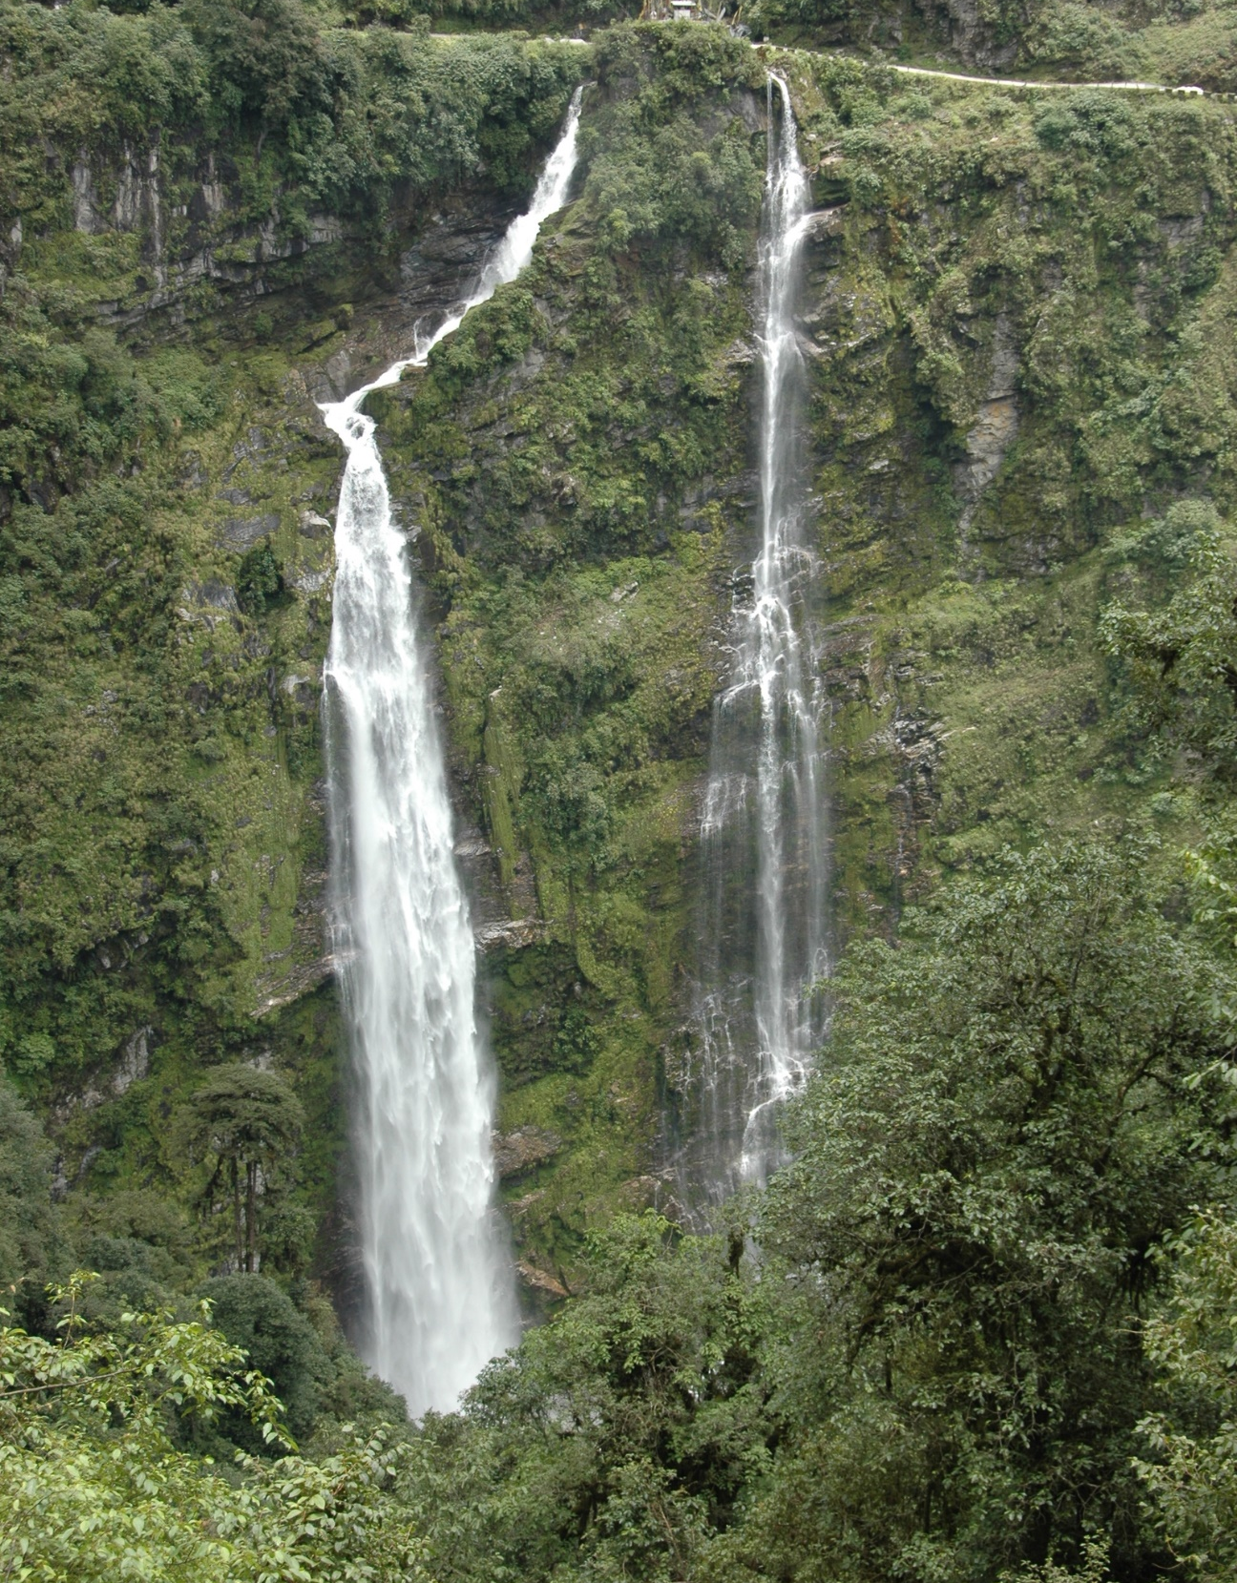
Final Products
ProDoc
Results Framework & core indicators worksheet
CEO Endorsement Request Document
Safeguards documents
Co-finance letters

Slide 15

Roles and Responsibilities

Slide 16

GEF Trustee
Implementation: GEF Project Agency
Execution: Executing Agency
Project partners

Slide 17
Roles in Project Development
Guide ProDoc development - GEF process, standards, policy and eligibility; strategic; financial
Political and institutional knowledge and relationships, important to include GEF Agency on political conversations
Assess EA capacities for successful project delivery
Ensure consistency with national priorities, plans, GEF
Ensures alignment with GEF priorities
Executing lead & partners
Check project meets/complies with policy
Project design: technical expertise, baseline, safeguards, gender, budget, implementation arrangement
GEF Agency
Manage relationship with GEF Sec, STAP, GEF Council, and GEF agencies
Coordination with partners, consultation with potential beneficiaries
Internal review and facilitate GEF Secretariat review. Final approvals
Identify baseline and co-financing

Slide 18
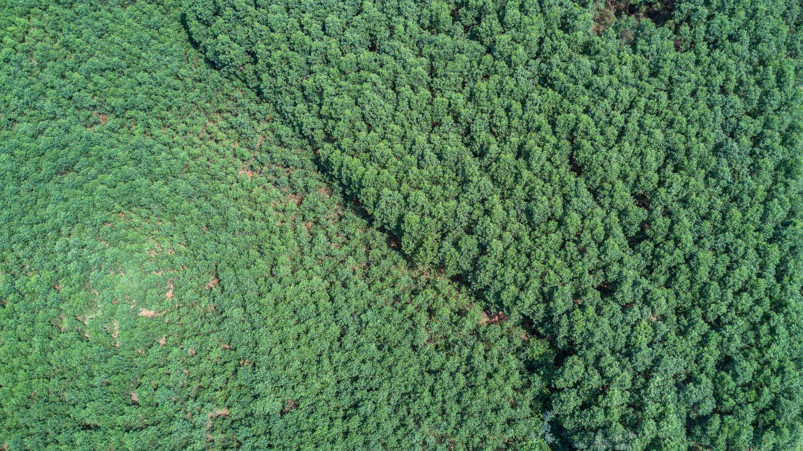
WWF GEF Agency Team
Agency
Senior Director: Herve LeFeuvre
Director: Renae Stenhouse
Senior Program Officer: Isabel Filiberto, Heike Lingertat, Rachel Kaplan,
Program Officers: Astrid Breuer, Jacquelyn Trudeau
Support
Safeguards: Erika Drazen
Gender: Nathalie Simoneau
M&E: Amelia Kissick
Financial Operations: Tracey Smith
Regional Support and Coordination
Africa: Peter Scheren

Slide 19
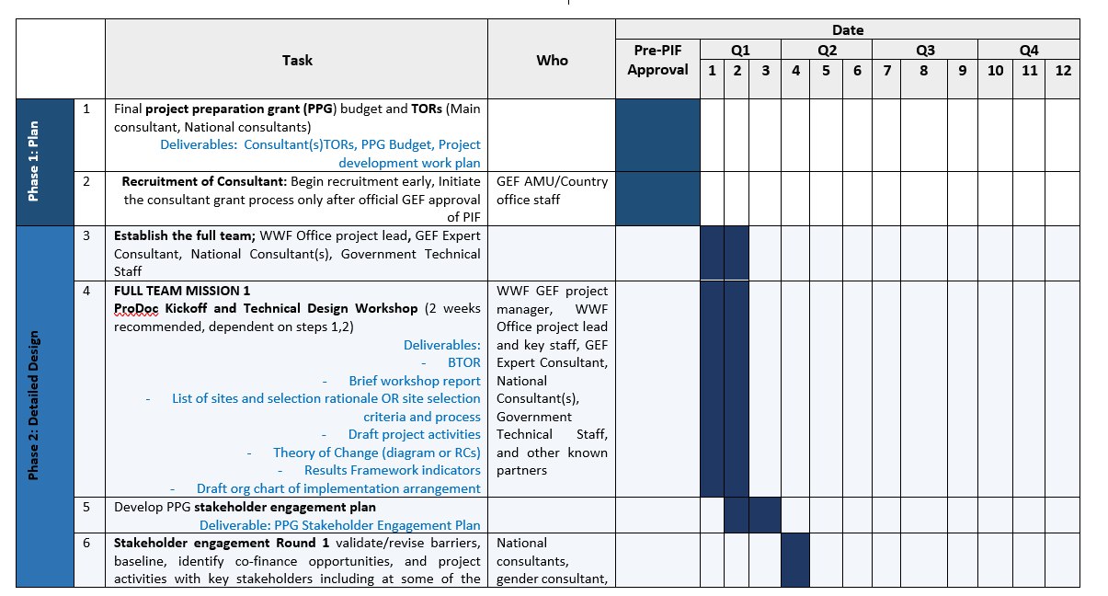
PPG Template
TBD
Notes:
Discuss who will be responsible for Stakeholder Consultations

Slide 20

Strategy
Designing a GEF Project Strategy

Slide 21
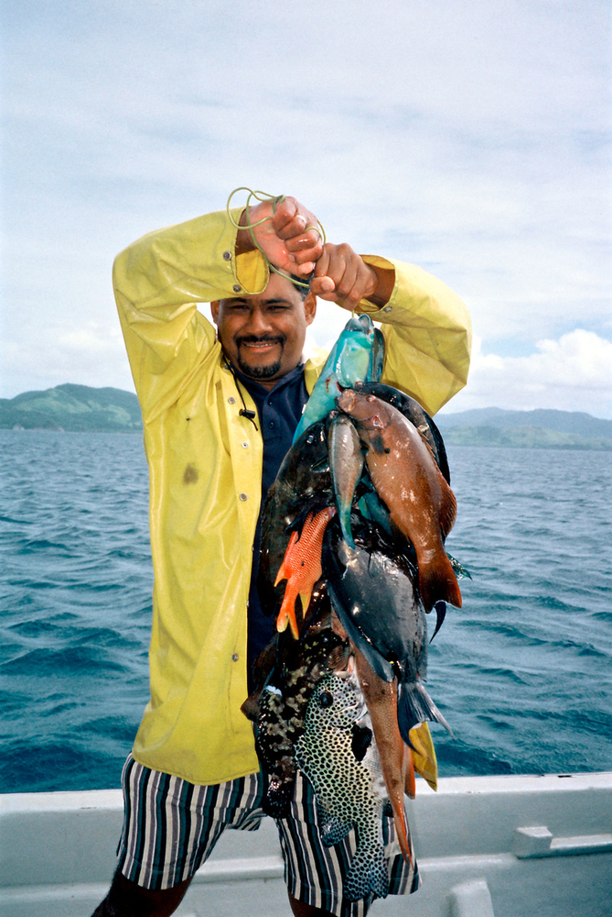
Defining Activity Level Detail
An Outcome is the medium-term effects achieved by an intervention’s outputs.
An Output is a tangible deliverable (e.g., workshop, report, etc.) and often leads to project outcomes/results.
Activities are the actions or tasks being undertaken by project staff or partners to achieve project outputs.
    What are we paying for?
    Who will do it?
    Will the series of activities deliver the output?

Slide 22
Project Strategy
Table B (approved at PIF)
Problem: Heike is hungry
An Outcome is the medium-term effect (e.g. alleviating hunger)
    An Output is the first level of result within the project. An output should be the tangible deliverable to achieve the outcome (e.g. Mars bar)
          Activities are the actions or tasks being undertaken by project staff or partners, and are associated with delivering project outputs (e.g. walking to the store, purchasing Mars bar, unwrapping Mars bar, eating Mars bar).
Project Components | Project Outcomes | Project Outputs
Component 1: National capacity and enabling environment for cross-sectoral coordination to promote forest and landscape conservation | Outcome 1.1: Improved inter-sectoral coordination from national, regional to district level for integrated forest and landscape management to support the 2015-2025 TAL Strategy | Output 1.1.1: Cross-sectoral coordination mechanisms established for: sub-committees under National Biodiversity Conservation Committee (NBCC) Coordination with environment, infrastructure, and development Ministries Landscape Support Unit (LSU) Task force(s) under TALWG for cross-sectoral communication on specific issues of overlapping land uses in TAL Department (DoF, DNPWC) representatives and regional focal points within MoFSC for intra-sectoral coordination Networking mechanism for District Forest Sector Coordination Committees (DFSCC) for 18 TAL Districts

Slide 23

Theory of Change
Key Question:
What barriers are contributing to the environmental problem and preventing the project objective from being achieved?
GEF project logic:
removing barriers through project strategies to achieve global environmental benefits

Slide 24
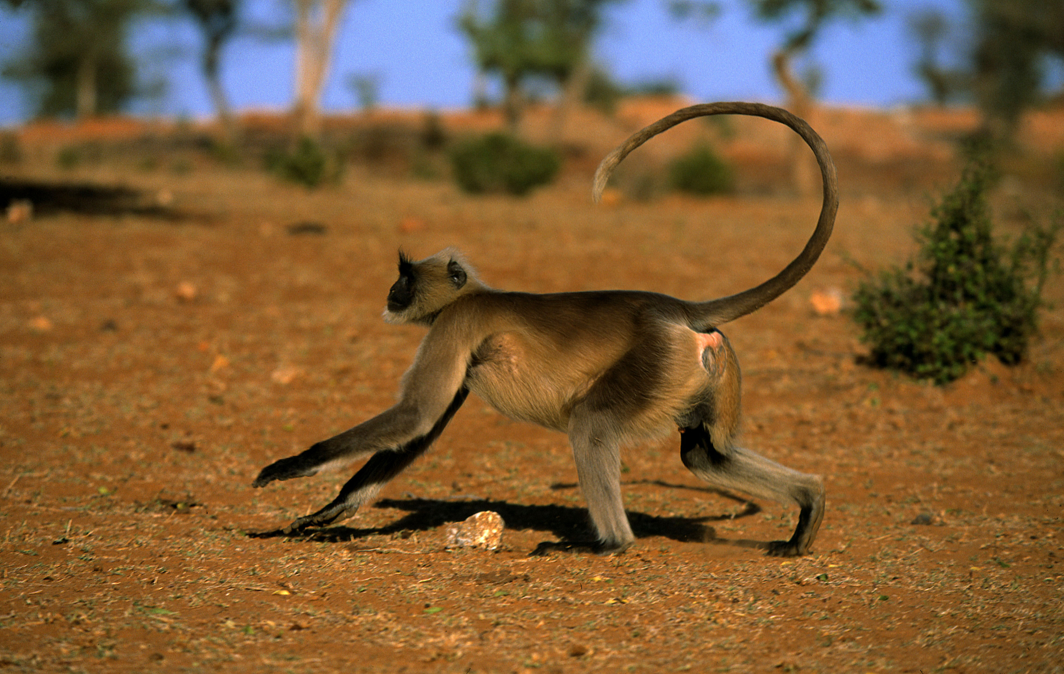
Monitoring and Evaluation

Slide 25

Defining Terms
  Monitoring: provides data on achievement of project indicators- Is project on track
  Evaluation: provides lessons learned and recommendations on WHAT works, what DOESN’T work, why and Who’s affected?

Slide 26
Results Framework
Used to show expected project impact at objective and outcome level
Completed once project design is finalized
SMART Indicators (quantitative)
Realistic and achievable targets (Will affect ratings)
Indicator Description | Unit | Definition | Method | Site | Frequency | Baseline | Who | Target Year 1 | Target Year 2
Project Objective
Component 1
Outcome 1.1
Outcome 1.2
Component 2
Outcome 2.1

Slide 27
Core Indicators
Insert core indictor information here:
Ie. 7.1
7.2
7.3
  Core indicator X: Fill this in based in on PIF

Slide 28

Gender

Slide 29
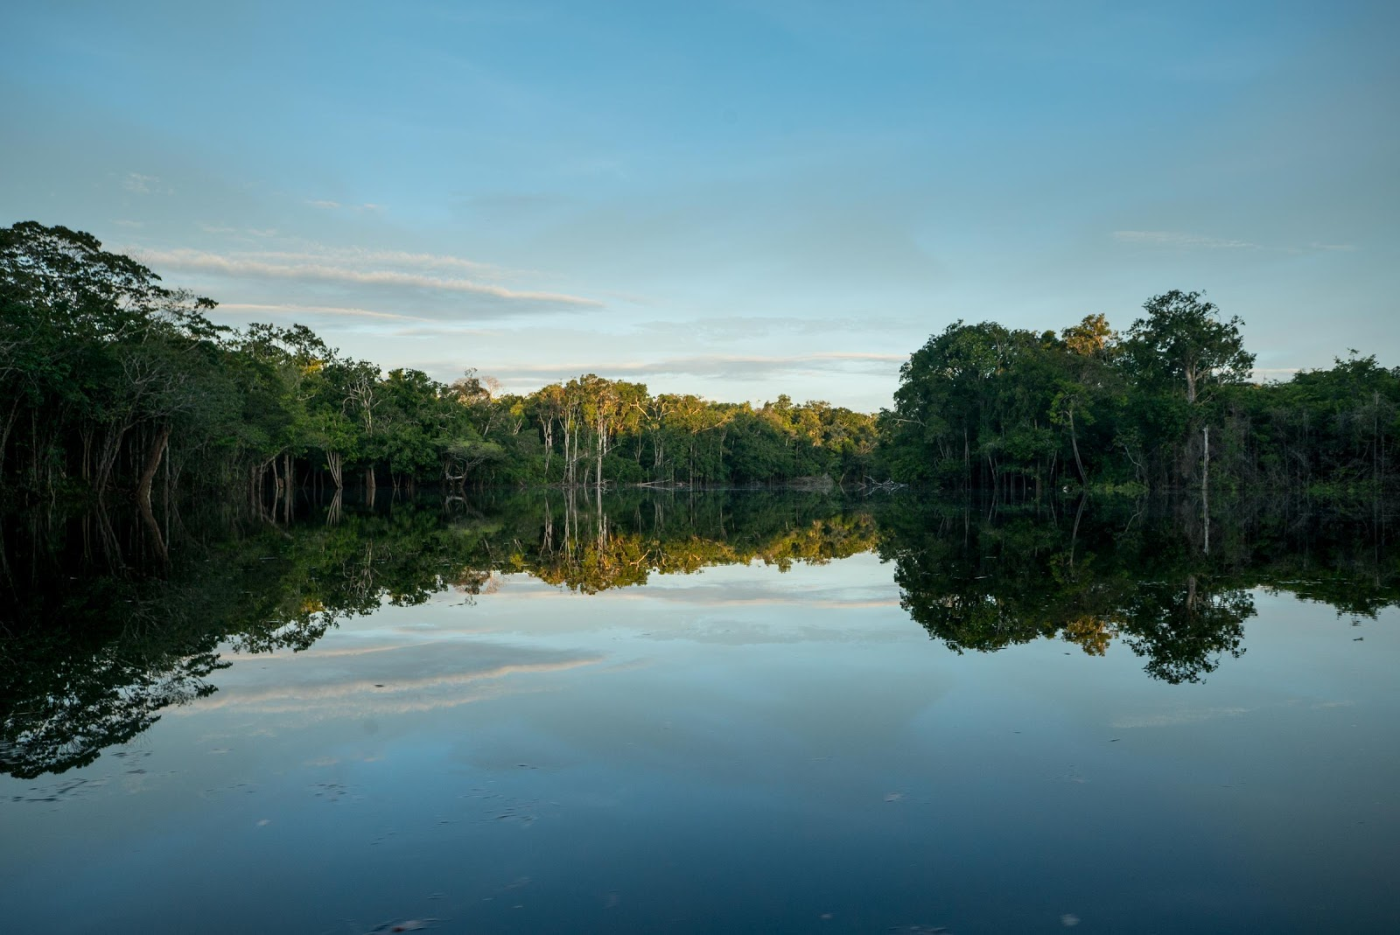
Gender Equality and Women’s Empowerment
As a GEF 7 project, there are GEF mandatory requirements from the new GEF Policy on Gender Equality (2017), that need to be followed which were not present in previous GEF cycles.
The mandatory requirements are in line with the WWF Network Gender Policy.
The EA is thus required to follow these requirements to address gender considerations, making the concerns, roles and experiences of women and men an integral part of the whole project cycle.

Slide 30

Gender Equality and Women’s Empowerment
Mandatory requirements at ProDoc stage - The project team is required to:
Undertake a desk study to identify gender issues as relevant to the country and specific to the project
Conduct gender-responsive Stakeholder Consultations
Conduct Socio-economic Assessment, including Gender Analysis
Produce a Gender Action Plan and inform the development of gender-responsive activities using the Socio-economic Assessment and Gender Analysis
The Results Framework contains gender-responsive actions - gender-specific indicators & sex-disaggregated data
Contribute to closing gender gaps and promote GEWE through at least one of these categories:
  Contributing to equal access to and control of natural resources of women and men
  Improving the participation and decision-making of women in natural resource governance
  Targeting socio-economic benefits and services for women

Slide 31
Gender
Desktop gender study
Results Framework indicators
Gender analysis
Gender-responsive activities
Gender Action Plan
Gender-responsive stakeholder consultations
Budget
Annual work plans

Slide 32
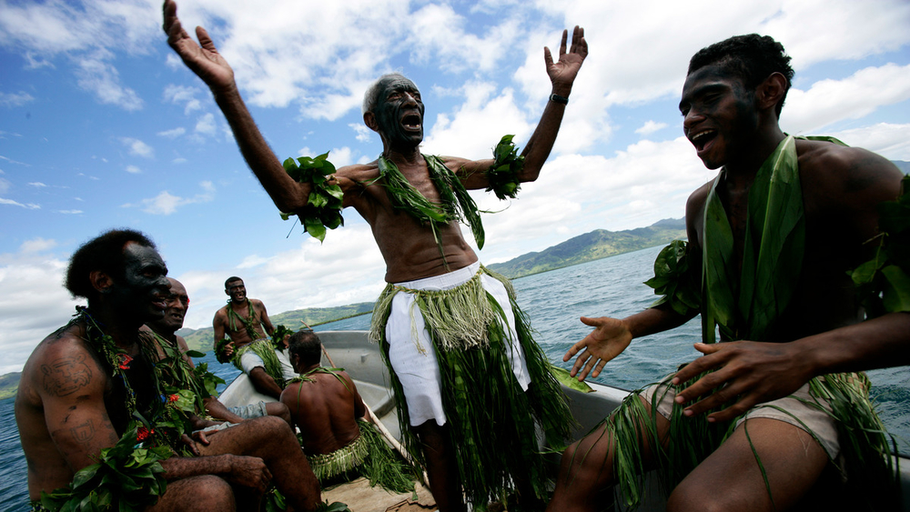
Safeguards

Slide 33
WWF Environmental and Social Safeguards Policies and Standards
Policy on Environmental and Social Risk Management
Policy on Protection of Natural Habitats
Policy on Involuntary Resettlement*
Policy on Indigenous Peoples
Policy on Accountability and Grievance Mechanism
Standard on Pest Management
Standard on Cultural Resources
Standard on Stakeholder Engagement
Standard on Public Consultation and Disclosure
Standard on Community Health and Security
*Includes Access Restrictions

Slide 34

ProDoc Stage Safeguards
What is Necessary to Start the Safeguards Process?
Activities to be financed
Sites (Exact locations are not necessary) should be informed by consultations with stakeholders
Budget Next steps
Safeguards Process are determined
based on above in consultation with the WWF-US Safeguards Coordinator
Required to do a landscape screening for any new landscapes involved

Slide 35
Who does what?
WWF Safeguards Coordinator
Project Executing Agency
Screens and sets Project Environment and Social Category
Advises Project Executing Agency on the WWF’s safeguards requirements
Reviews and approves safeguards documents
Discloses final safeguards documents
Prepares and Implements all safeguards documents in accordance with national laws and WWF safeguards policies
Consults project-affected groups and local NGOs
Discloses final documents in country
Preparation
Monitors implementation of safeguards documents and periodically reports and responds to WWF GEF/GCF Agency
Ensures compliance under national laws
Monitors implementation of safeguards documents and periodically reports and responds to WWF GEF/GCF Agency
Ensures compliance under national laws
Supervises implementation of safeguards instruments
Makes mutually agreeable changes during implementation
Monitors implementation of safeguards documents and periodically reports and responds to WWF GEF/GCF Agency
Ensures compliance under national laws
Implementation

Slide 36
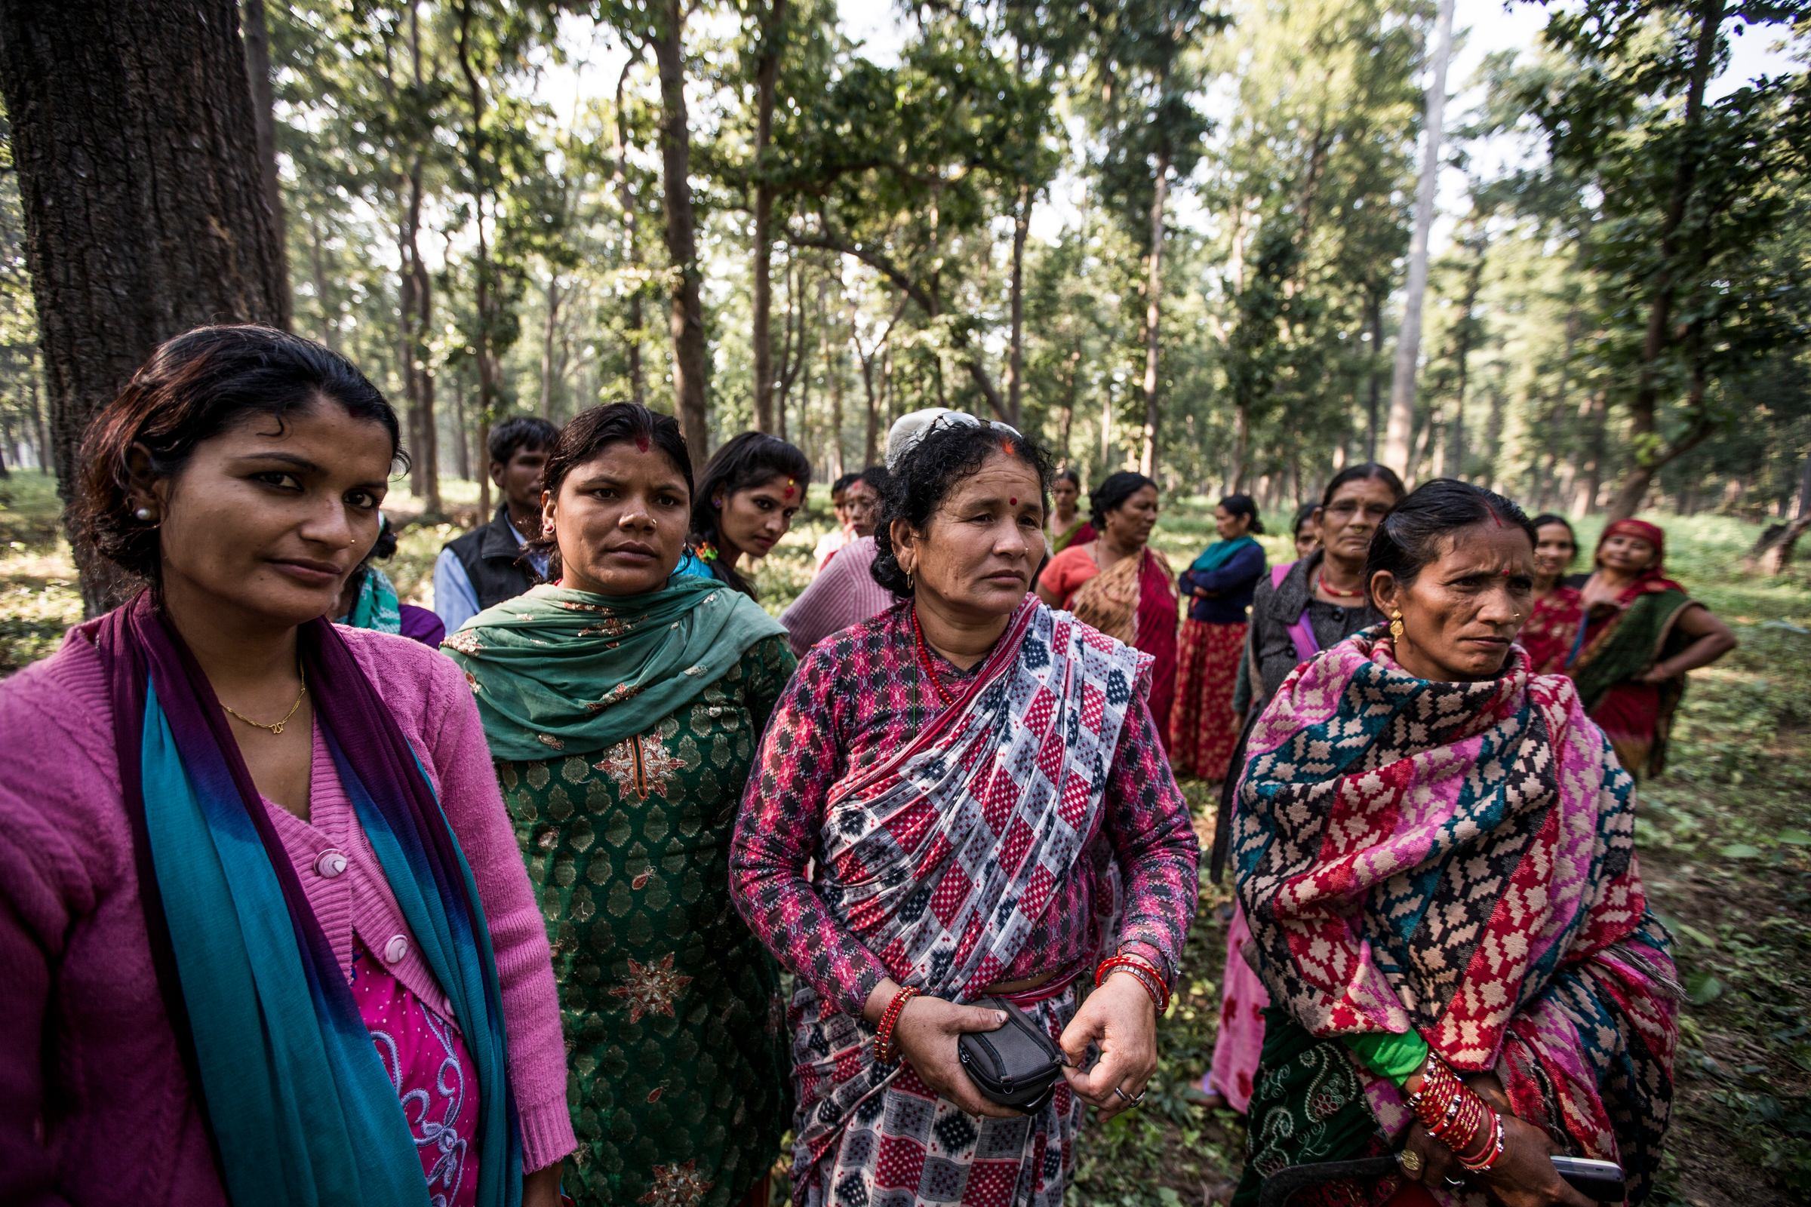
Stakeholder Engagement

Slide 37

Who are Stakeholders?
All individuals, groups, institutions that have an interest in, will be directly or indirectly affected by, or may influence outcomes of, the project.
E.g. community members, government, donors, NGOs, CSOs, private sector
Receive feedback from stakeholders on the project and incorporate feedback into project design, and
To determine how and when stakeholders will be engaged during project implementation.

Slide 38
Importance of Stakeholder Engagement & The SEP
Compliance WWF and GEF Policies around Stakeholder Engagement
  See GEF Public Involvement Policy
  WWF GEF Stakeholder Engagement Policy
ProDoc: Need to document how stakeholders were engaged, main reflections, how these reflections were incorporated into the project design, and how stakeholders will continue to participate in project implementation
Stakeholder Engagement Plan (SEP)
  Build off of Stakeholder Analysis
  Consult with stakeholders
  Incorporate feedback from stakeholders in draft SEP and project design
  Describe grievance redress mechanism
  Include budget
  Final validations of SEP by stakeholders prior to project implementation
  Disclose final SEP

Slide 39
Steps for Stakeholders Engagement
Step | How? | Output
Step 1: define stakeholders | Develop a broad list of stakeholders and their known role | List of Stakeholders
Step 2: consultation with stakeholders | face to face meetings, workshops to discuss project objectives, roles, proposed activities, their needs, their feedback | Matrix of stakeholders, their baseline, their potential roles, and their feedback on concept.
Step 3: analysis. | Analyze stakeholders’ potential role and contributions in the proposed project, issues of concern held by stakeholders, their key project needs. - Identify influencers/powerful stakeholders and marginalized people | Stakeholder analysis, included in the ProDoc
Step 4: prioritize | Prioritize (more narrowly) the stakeholders that are likely to be executing partners, and other key groups that the project will work with, such as indigenous communities. | Executing partners, beneficiaries
Step 5: inclusion of feedback in project design | Include key outcomes from stakeholder analysis and consultations into project design and Include project partners in developing results chain, project activities, budget, M&E | Stakeholder input to project design Budget and activities account for stakeholder roles
Step 6: define project governance | What are the roles and accountability across all executing partners for stakeholder engagement | Project governance structure Stakeholder Engagement Plan.

Slide 40
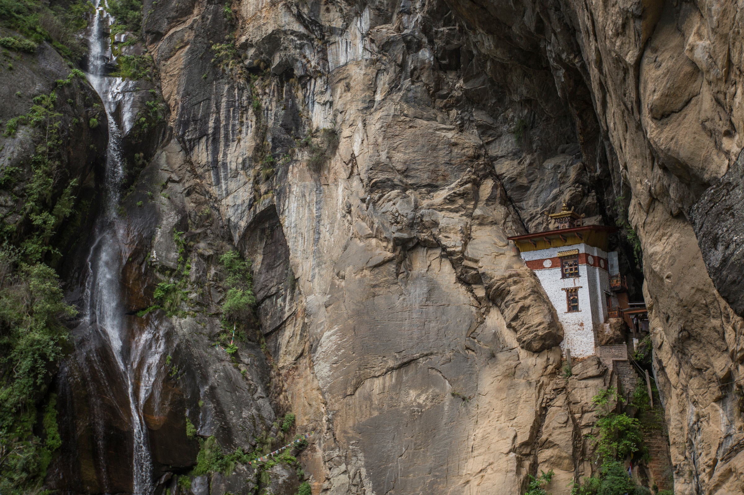
Project Governance

Slide 41
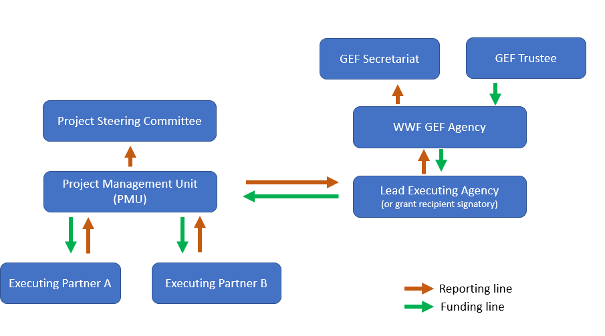
Project Governance during Execution
PSC is a final decision-making group and should include membership from key project partners – both executing project activities as well as providing co-financing or strategic support to the project.
PMU = project day-to-day management

Slide 42
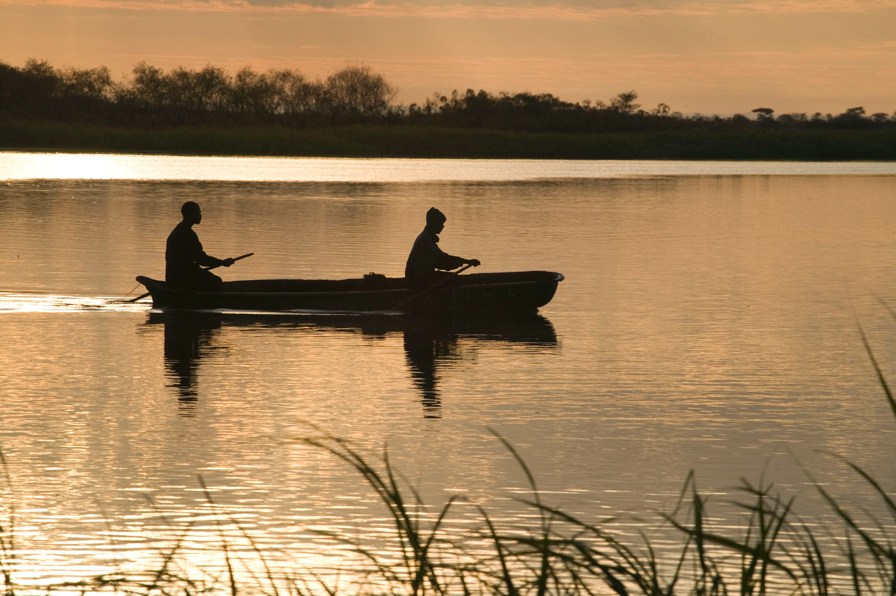

Budget

Slide 43

General Budget Guidance
A Budget template has been developed specifically for this project that will guide the creation of a general ledger-based budget under each Component and Outcome.
In addition to the budget template, budget notes will be required that explain how all cost estimates were derived and illustrates how the costs are necessary to accomplish the outcomes of the project.
The total budget for each component should not vary from the PIF more than 5%.
All Partners (sub-agreements) receiving at least USD$300,000 must provide a detailed budget using template, as well as budget notes
Project Management Costs PMC can be up to 5% of the subtotal

Slide 44

Next Steps

Slide 45

Timeline / Work Plan for Project and ProDoc Development
Discuss timeline for next steps

Slide 46
Photo Credits
© Simon Rawles / WWF-UK
© George Holton / WWF-US
© Tashi Tshering / WWF Bhutan
© Bruce W. Bunting / WWF-US
© DoFPS, Bhutan
© WWF-US /Drew Crandall
© Stéfane Mauris / WWF
© Staffan Widstrand / WWF
© Martin Harvey / WWF
© David Lawson / WWF-UK
© James Morgan / WWF-US
© naturepl.com / Tim Laman / WWF
© Rachel Kramer / WWF-US
© Cat Holloway / WWF
© Brent Stirton / Getty Images
© Jürgen Freund / WWF

